Slide 1
Acute dysbiosis
Absence or presence of community-level function
Any healthy donor
Maximize metabolites or perform ex-vivo experiments
Absence or presence of individual taxa
Complex interplay with host phenotype
Maximize missing taxa or competitors
Learn computational model to score donors

Slide 2
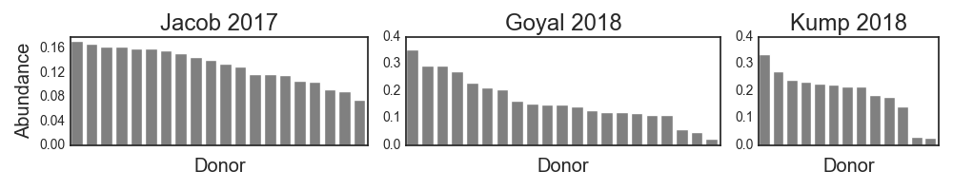
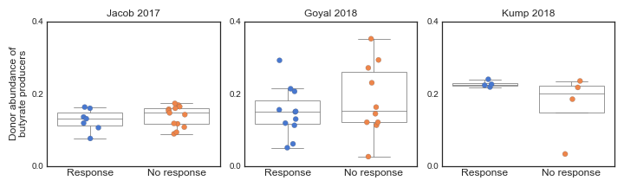
A
B

Slide 3
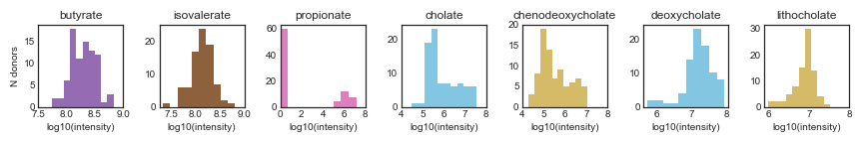
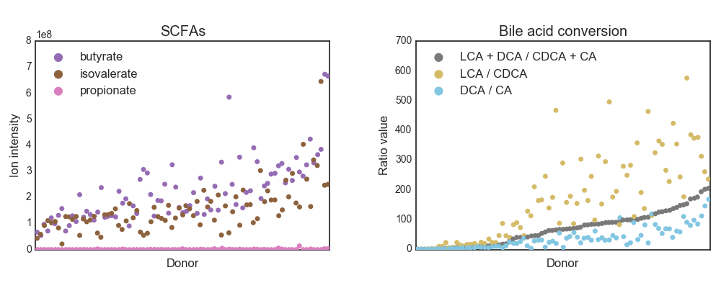
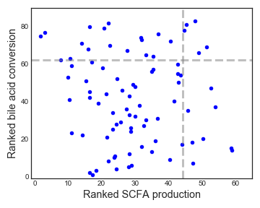
A
B
C

Slide 4
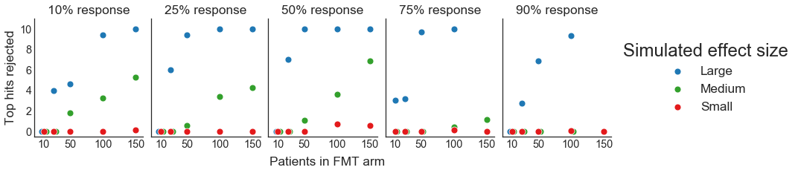

Slide 8
Acute dysbiosis
Absence or presence of individual taxa
Absence or presence of community-level function
Maximize missing taxa or competitors
Any healthy donor
Ex-vivo experiments
Complex interplay with host phenotype
Little understanding of disease model
?
Learn ML model to score donors
Pick different healthy donors

